Slide 1

Predictive Irrigation
Water Sustainability
Predictive Irrigation
By
Legacy Coders
There’s no traffic on the extra mile
Notes:
Please be as creative as you can with the template

Slide 2

Predictive Irrigation
Agriculture is by far the largest water consumer, accounting for 69% of annual water withdrawals globally.​
How can we efficiently use very limited source of fresh water available so that we can feed growing population?

Slide 3
IoT Based Solution
Send Soil Moisture data to Cloud using IoT enabled sensor
Machine Learning Algorithm predicts amount of water needs to be irrigated based on
Crop Data
Weather Forecast
Watson IoT Actuates drip irrigation pumps to required level of watering
Dashboard for farmers

Slide 4
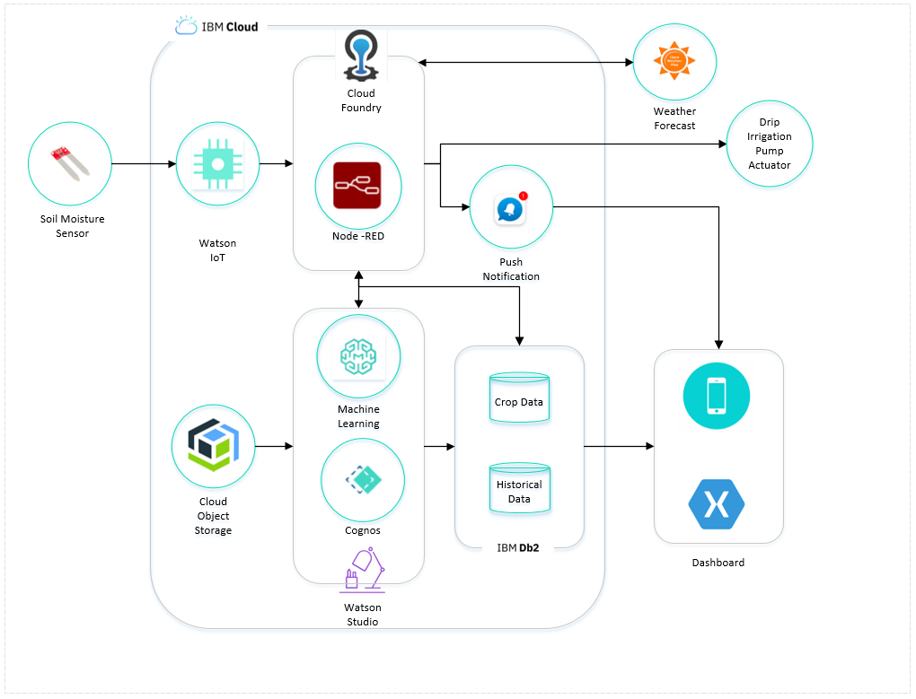
HOW IT WORKS
Technical Architecture

Slide 5
Road Map
Mobile app with user friendly dashboard with current & predicted soil moisture​​
Alert messages through Push notifications

